Slide 1
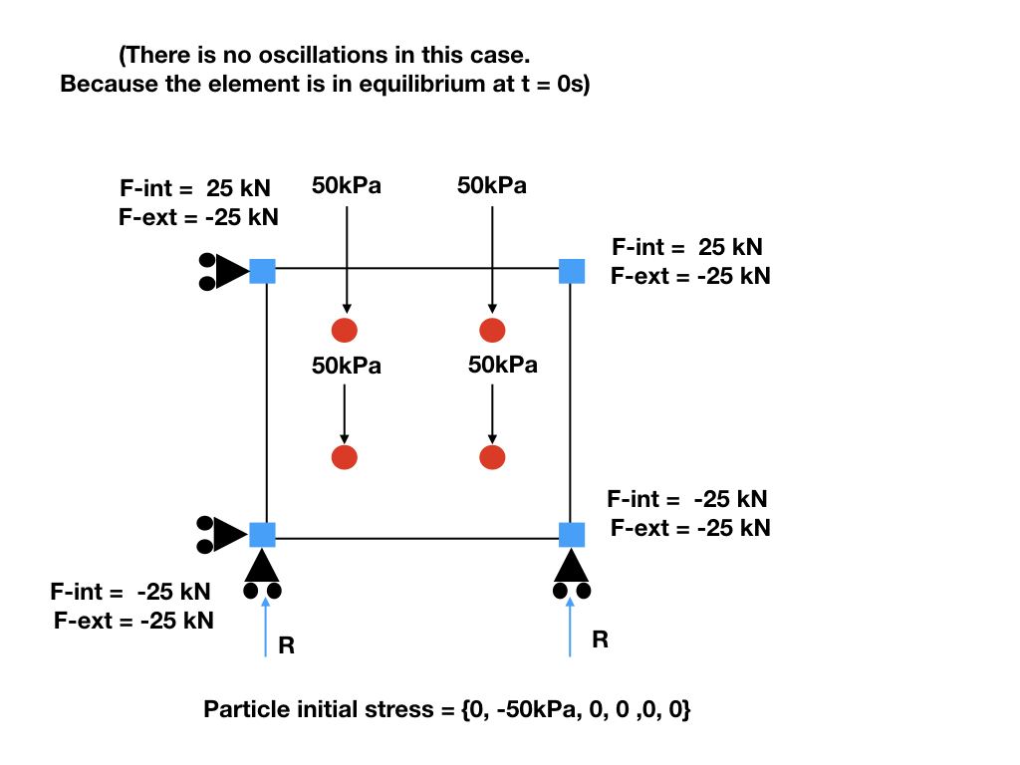
N3
N2
P2
P3
P0
P1
N0
N1
No initial stress would lead to oscillation
Figure made by Shyamini Kularathna
Modified by Ezra Setiasabda

Slide 3
Nodal Forces (1)

Slide 4
Nodal Forces (2)

Slide 5
Nodal Forces (3)

